Slide 1

JavaScript
.NET

Slide 2
JavaScript (JS) programming language conforms to the ECMAScript specification. JavaScript is a high-level language that is just-in-time compiled, has curly-bracket syntax, dynamic typing, prototype-based object-orientation, and First-class functions (they are treated like a variable).
https://en.wikipedia.org/wiki/JavaScript

Slide 3
Create Sample .HTML and .js docs
<!DOCTYPE html>
<html lang="en">
<head>
<meta charset="UTF-8">
<meta name="viewport" content="width=device-width, initial-scale=1.0">
<meta http-equiv="X-UA-Compatible" content="ie=edge"> <title>JS Example Document</title> </head>
<body>
<script src="functions1.js"></script>
<script src="function2.js"></script> </body>
</html>
Create a .html document and create the HTML template inside (use ‘doc’ shortcut).
This can be used to experiment with the examples in the presentation.
The .js file and the .html file should be in the same folder.

Slide 4


Debugging in Chrome https://javascript.info/debugging-chrome
All modern browsers and most other environments support Debugging Tools.
Debugging Tools is a special UI in developer tools that makes debugging in the browser much easier. It allows you to trace the code step-by-step to see what is happening.
Chrome has many features and most other browsers have a similar process.
Follow this tutorial to learn how to debug in Chrome (or any other browser).

Slide 5

JavaScript – Overview https://www.w3schools.com/js/default.asp
JavaScript was invented by Brendan Eich in 1995 and became an ECMA standard in 1997. ECMAScript is the official name of JavaScript.
It’s one of the 3 languages all web developers learn:
1. HTML defines the content of web pages.
2. CSS specifies the layout of web pages.
3. JavaScript is for programing the behavior of web pages.
JS is well-known as the scripting language for web pages, but many desktop and server programs use JavaScript also. Node.js, jQuery, Angular, React, Vue and many others are examples of programs that use JS or are libraries of JS.

Slide 6
Is there an official JS reference?
Nope. We’ll use these.
https://developer.mozilla.org/en-US/docs/Web/JavaScript/Guide
The Modern JavaScript Tutorial
https://en.wikipedia.org/wiki/JavaScript
https://javascript.info/

Slide 7
JavaScript – Overview https://developer.mozilla.org/en-US/docs/Web/JavaScript
JavaScript (JS) is a prototype-based, multi-paradigm, single-threaded, dynamic, case-sensitive, interpreted (just-in-time compiled) programming language that supports object-oriented, imperative, and declarative (functional) programming styles.
JavaScript is separate from the Java programming language.
Although both "Java" and "JavaScript" are registered trademarks of Oracle,
the two languages have different syntax, semantics, and uses.

Slide 8
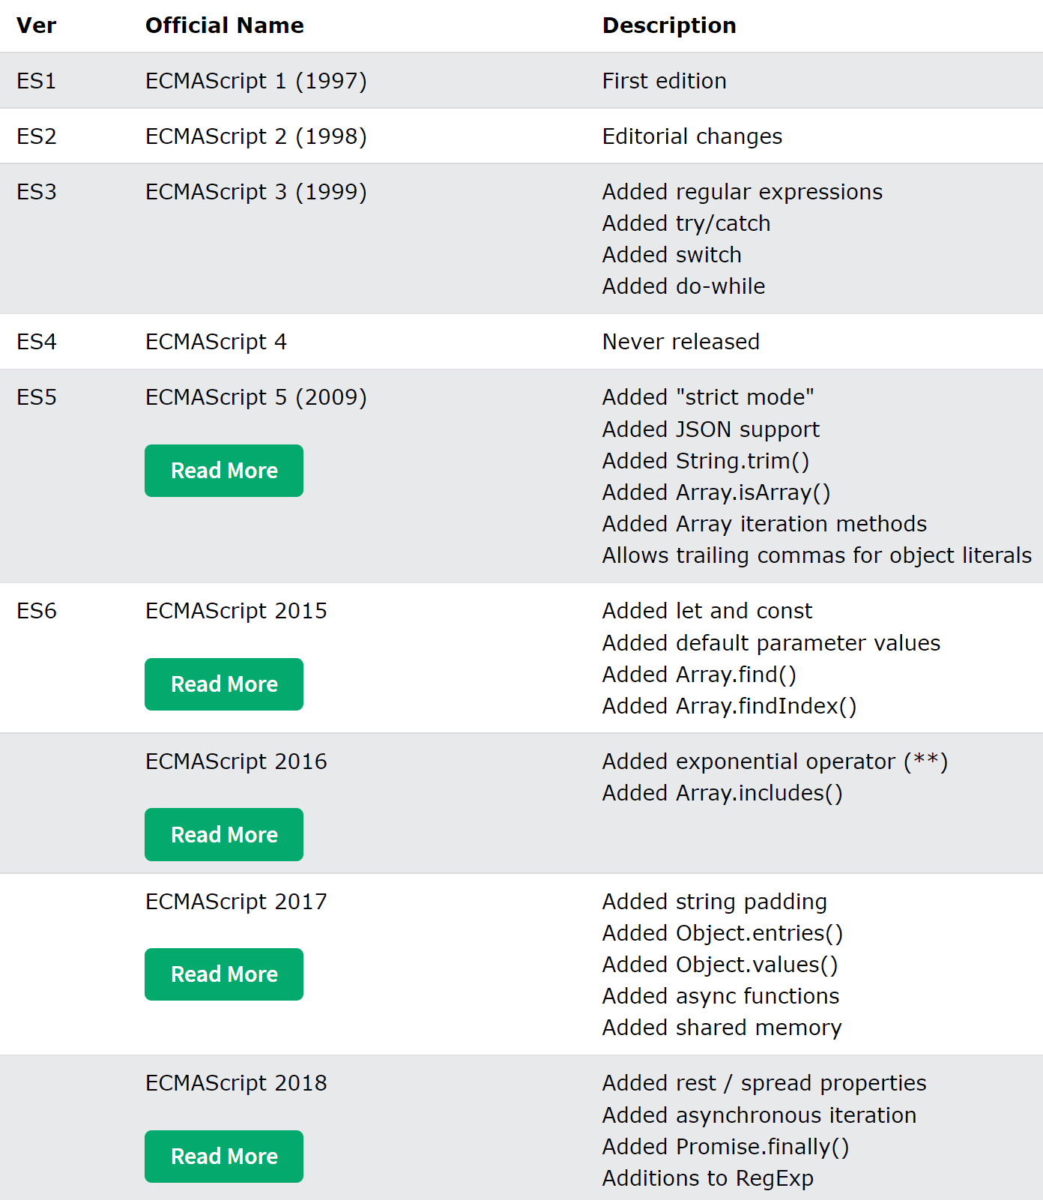
JS Versions https://www.w3schools.com/js/js_versions.asp
It is important to understand that JavaScript has changed over time and will continue to change in the future. The major additions to EMCAScript have been:
EMCA3. try/catch handling, better string handling, and numeric output formatting were introduced.
ES6. classes, ‘let’ and ‘const’, iterators, and arrow functions.
ECMAScript 2017. Async Functions.
Since ES6 it was decided to release a new version every year with iterative improvements.

Slide 9
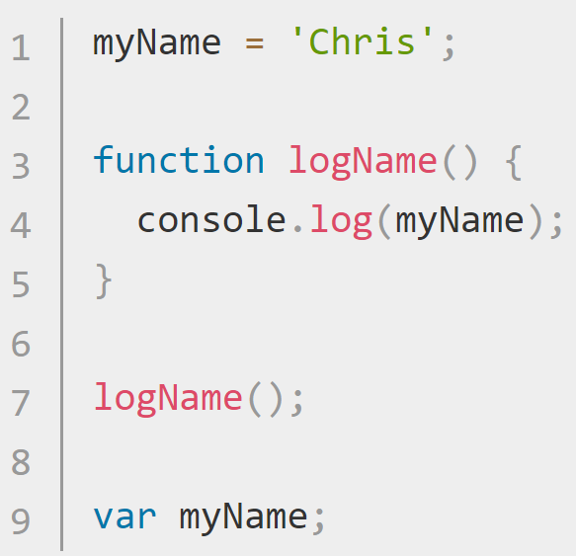
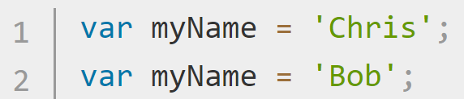
Declaring Variables (var, let, and const) https://developer.mozilla.org/en-US/docs/Learn/Getting_started_with_the_web/JavaScript_basics https://developer.mozilla.org/en-US/docs/Learn/JavaScript/First_steps/Variables#The_difference_between_var_and_let
JS creates variables in three ways. ‘let ’, ‘var’, and ‘const’
Originally, only var existed. The design of var can be confusing. With hoisting, a variable can be initialized before being declared. You can also redeclare a variable multiple times with var.
let was created to fix issues with var.
Use let (rather than var) unless you need to support versions of IE below v11. var is function or globally scoped and let is block scoped.
With const, a variable can be declared that cannot be altered later. Otherwise, it’s just like let.

Slide 10


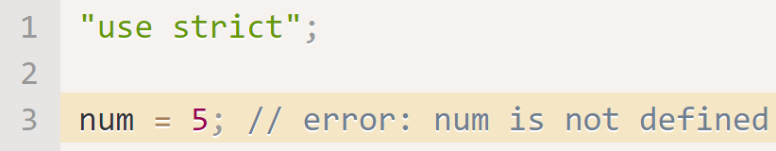

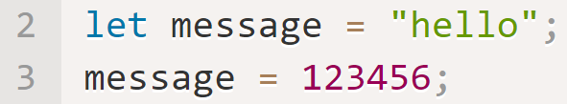
Variable Declaration Rules https://javascript.info/variables#a-variable
Variables objects with helper methods. (more)
You don’t have to declare variable types in JavaScript.
Numbers don’t need quotes, but strings and chars do.
You an declare multiple variables in one line.
camelCase is conventionally used for variables
Variables cannot start with a number.
Variables are case-sensitive.
Conventionally, chars (0-9, a-z, A-Z) are used for variables.
Don’t use JS keywords.
Place “use strict”; at the top of .js files to enforce newer conventions (like declaring a variable before defining it).
Declare an unchanging variable with const.
Use ALL CAPS for const variables known before compile-time.
Use meaningful names for variables.
JS is dynamically typed. This means a variable can be a string and then be a number and then be a float.

Slide 11
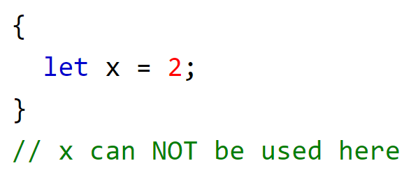
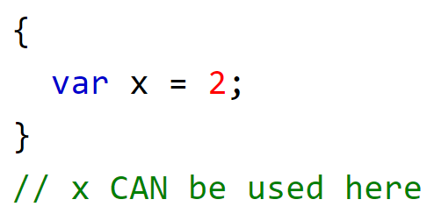
Scope – Global, Function, Block https://www.w3schools.com/js/js_scope.asp
Block Scope: let and const provide Block Scope. Block scope means that variables declared inside a { } block cannot be accessed from outside the block.
Variables declared with var do not have block scope. With var, variables declared inside a { } block can be accessed from outside the block.
Function Scope: Variables declared within a JavaScript function, become local to the function.
Global Scope: A variable declared outside a function has Global Scope.

Slide 12
Primitive DataTypes https://javascript.info/types
Datatype | Example | Details
Number (int) | let num = 10; | Operations include *, /, +, -, %, etc. Also includes NaN (not a number) and infinity
Number(floating point) | let num1 = 7087.542
BigInt | 123456789078901234567890n; | Represents any value > -2^53 or < 2^53. Use ‘n’ at the end of a BigInt.
String | let str1 = “there“; let str2 = ‘tiger’; let str3 = `Hey ${str1}, ${str2}`; | Surrounded by quotes. ‘str’, “str”, and `str` (backticks) are valid. Use `str ${otherStr}` for string interpolation. JS has no char type.
Boolean | let isBool = true; let isTrue = 2>1; //an expression | Only has 2 values.
null | let age = null; | A special value which represents “nothing”, “empty” or “value unknown”. null is not a reference to an object.
undefined | let x; //x is undefined | “value is not assigned”.

Slide 13
Object Data Type (and Misc.) https://javascript.info/types
Datatype | Example | Details
Object | //use a constructor let john = new User(); //build a 1-time use object let user = { name: "John", age: 30 }; | Objects are used to store collections of data and more complex entities in a key-value pair format.
typeof operator | Console.log(typeof x); Console.log(typeof(x)); | Returns a string of the type of the argument. It’s useful when processing different types differently.
Symbol | let id = Symbol("id"); | Object property keys may only be either of string type, or of symbol type. Symbols are guaranteed to be unique.

Slide 14
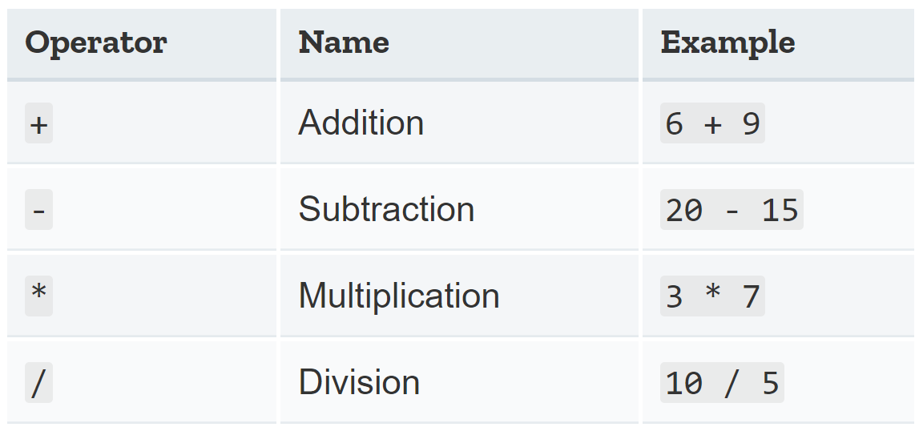
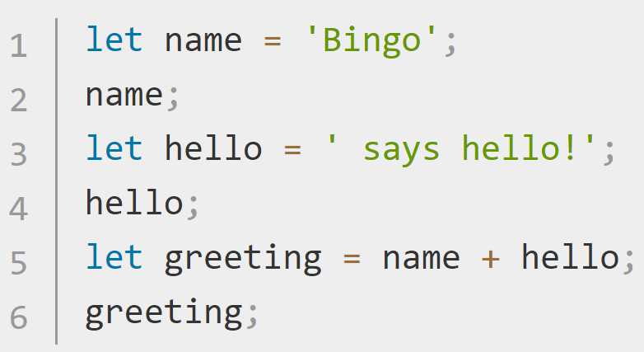
Operands and Operators https://developer.mozilla.org/en-US/docs/Learn/JavaScript/First_steps/A_first_splash https://javascript.info/operators#terms-unary-binary-operand
An operand is the value on which operators act.
In the expression ‘5 * 2’ there are two operands: the left operand is 5 and the right operand is 2.
JavaScript operators allow us t o perform tests, do math, concatenate strings, etc. A unary operator has a single operand (let x = 4;). A binary operator has two operands (let x = y + z;).
You can also use the + operator to add and join text strings together. In JS, if one operand is a string, the other is converted to a string. (Ex. let new = “hello” + 4;) // ‘hello4’
Use PEMDAS for order of operations: Parentheses, Exponents, Multiplication, Division, Addition, Subtraction.
What is the result of this expression? 10/(3+2)*4+5**2+6-9

Slide 15
Operators https://javascript.info/operators
Operator | Example | Description
% | 6%4 == 2 | % is modulus and gives the remainder.
++ | If a = 5, a++ === 6 | ++ increments by 1. - - decrements by 1. Placed before the variable, ++ or - - occurs before the action. Placed after the variable, ++ or - - happens after the action.
- - | a = 5, a- - == 4
** | a == 4, b == 3; a**b == 64. | ** is the exponent operator. a is multiplied by itself b times.
+= | let n = 2; n += 5 == 7 | Modify-in-place. Shorthand notation to add, subtract, multiply or divide then save the result to the left-hand variable;
-= | let n = 2; n -= 5 == -3
*= | let n = 2; n *= 5 == 10
/= | let n = 10; n /= 5 == 2

Slide 16
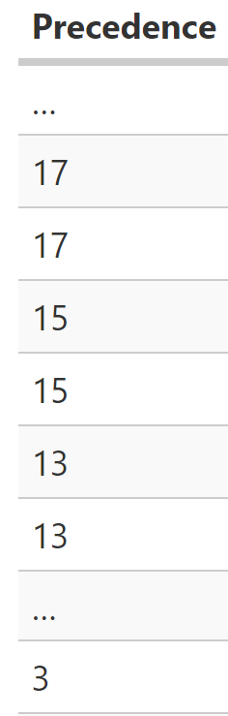
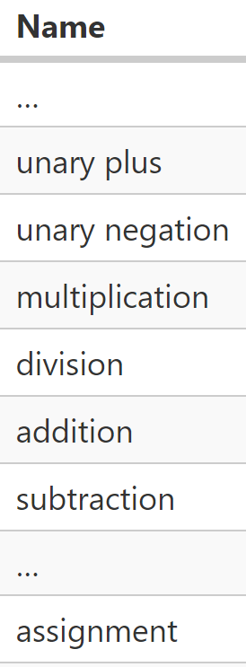
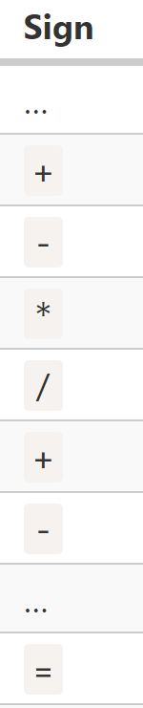
Operator precedence https://javascript.info/operators#operator-precedence https://developer.mozilla.org/en/JavaScript/Reference/operators/operator_precedence
Execution order is defined by operator precedence. Parentheses have the highest precedence. (1 + 2) * 2 = 6.
Every operator has a corresponding precedence number. The operator with the higher number executes first. If the precedence is the same, the execution order is from left to right.
You can also chain assignments.
In a = b = c = 2 + 2; a, b, and c == 4.

Slide 17
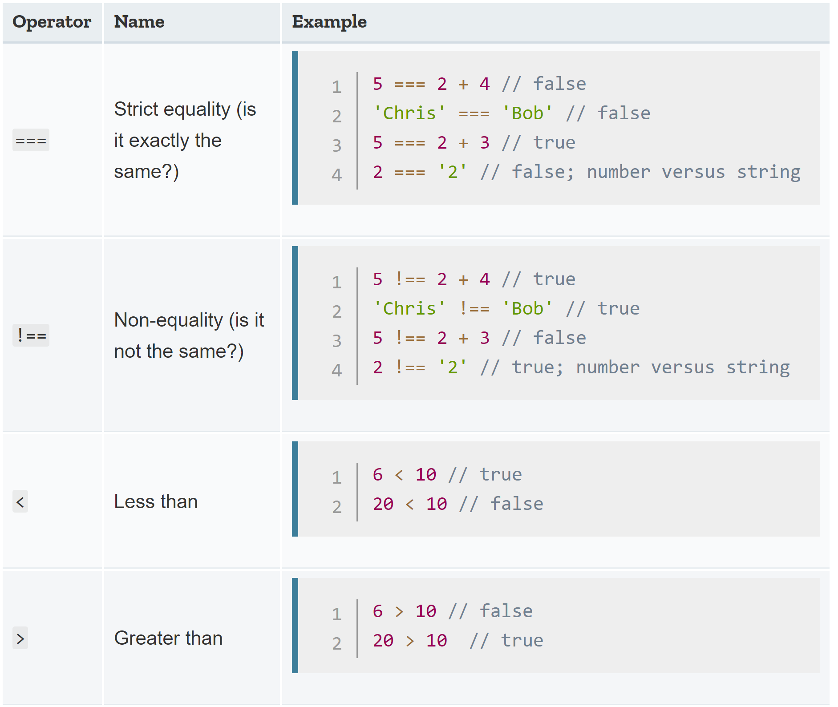
=, ==, and === Operators https://javascript.info/object#copying-by-reference
= | == | ===
Assignment | Equality (with type coersion) | Strict equality
Let a = { }; Let c = { }; let b = a; let d = “13”; let e = 13 | a == b //true | a === b //true
 | a == c //false | a === c //false
 | d == e //true | d === e //false

Slide 18
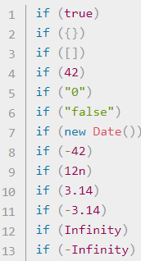
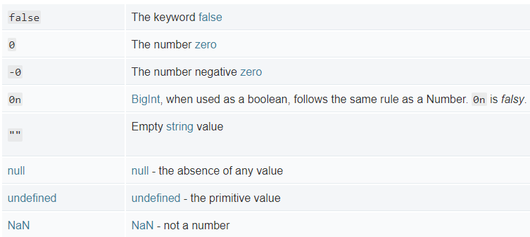
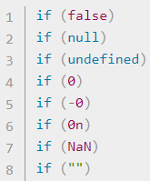
Truthy vs Falsy https://javascript.info/logical-operators https://developer.mozilla.org/en-US/docs/Glossary/Truthy https://developer.mozilla.org/en-US/docs/Glossary/Falsy
A truthy value is a value that is considered true when viewed in a Boolean context. All values are truthy unless they are defined as falsy.
A falsy value is a value that is considered false when viewed in a Boolean context.

Slide 19
Type Conversion https://javascript.info/type-conversions
Most of the time, operators and functions automatically convert the values given to them to the correct type. The three most widely used conversions are to string, to number, and to boolean.
String(x) | Number(x) |  | Boolean(x)
Any value can be converted to a string. | If the input is… | The result is…. | Input | Result
 | undefined | NaN | 0 null undefined NaN “” ‘’ | false
 | null | 0
 | true / false | 1 / 0
 | String that’s not a number. | Whitespaces are ignored. An error gives NaN.
 | string | An empty string becomes 0. | anything else | true

Slide 20
JavaScript – Math object Functions https://developer.mozilla.org/en-US/docs/Web/JavaScript/Reference/Global_Objects/Math
JavaScript has a built-in Math object which contains a small library of mathematical functions and constants.
Function | Description | Example
Math.random(); | returns a floating-point, pseudo-random number in the range 0 to < 1 | Math.random()*10; //3.229976827519583
Math.abs(x); | returns the absolute value of a number | Math.abs(-10 – 6.3); //16.3
Math.pow(x,y); | returns x to the power of y | Math.pow(7, 3); //343
Math.floor(x); | returns the largest integer less than or equal to a given number | Math.floor(5.05) //5
Math.ceil(x); | rounds a number up to the next largest whole number or integer. | Math.ceil(11.324); //12
Math.max(a,b,…z) | returns the largest of zero or more numbers | Math.max(1, 3, 2); //3

Slide 21
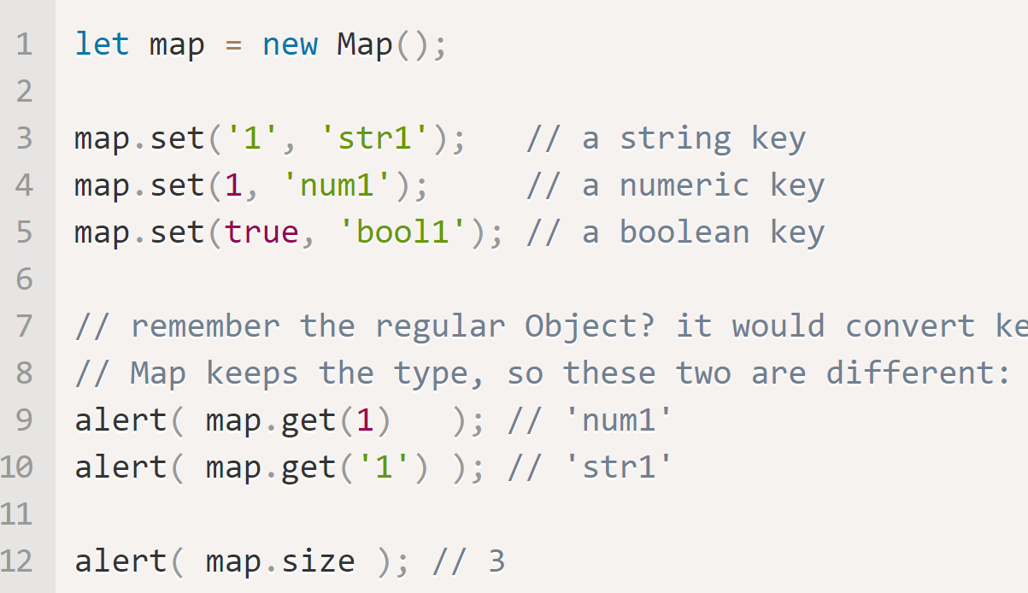
Map https://javascript.info/map-set#map https://javascript.info/weakmap-weakset#weakmap
Map
Map is a collection of key-value data items, just like an Object.
Any type of key is possible, even Object.
Insertion order is used for iteration order.

Slide 22
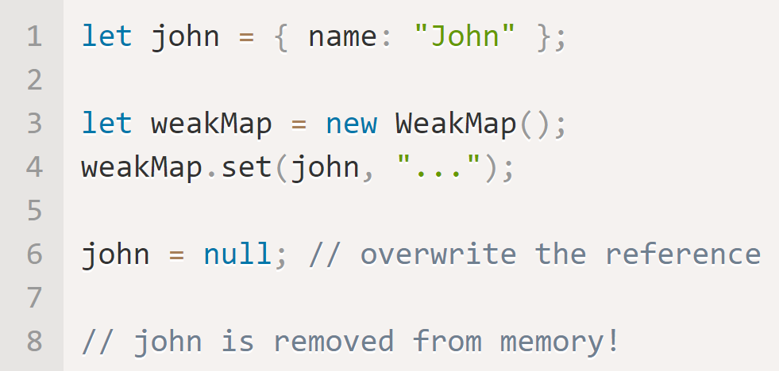
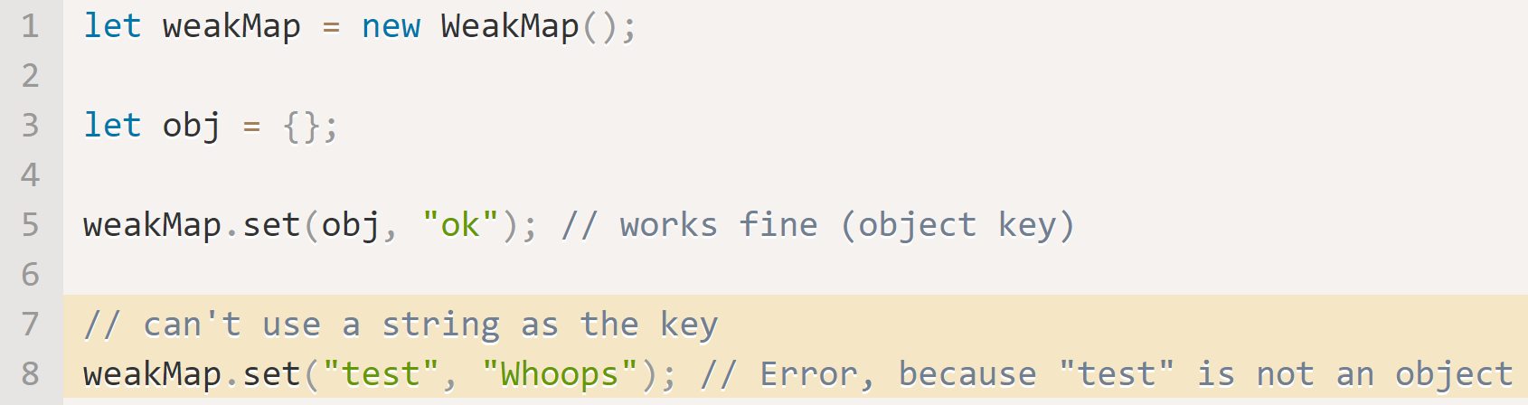
Weak Map https://javascript.info/weakmap-weakset#weakmap
WeakMap
WeakMap keys must be objects
There is no way to get all keys or values from a weak map
If you remove all other references to an object key, the object is removed from memory and the WeakMap().
WeakMap does not support iteration or the methods keys(), values(), entries()

Slide 23
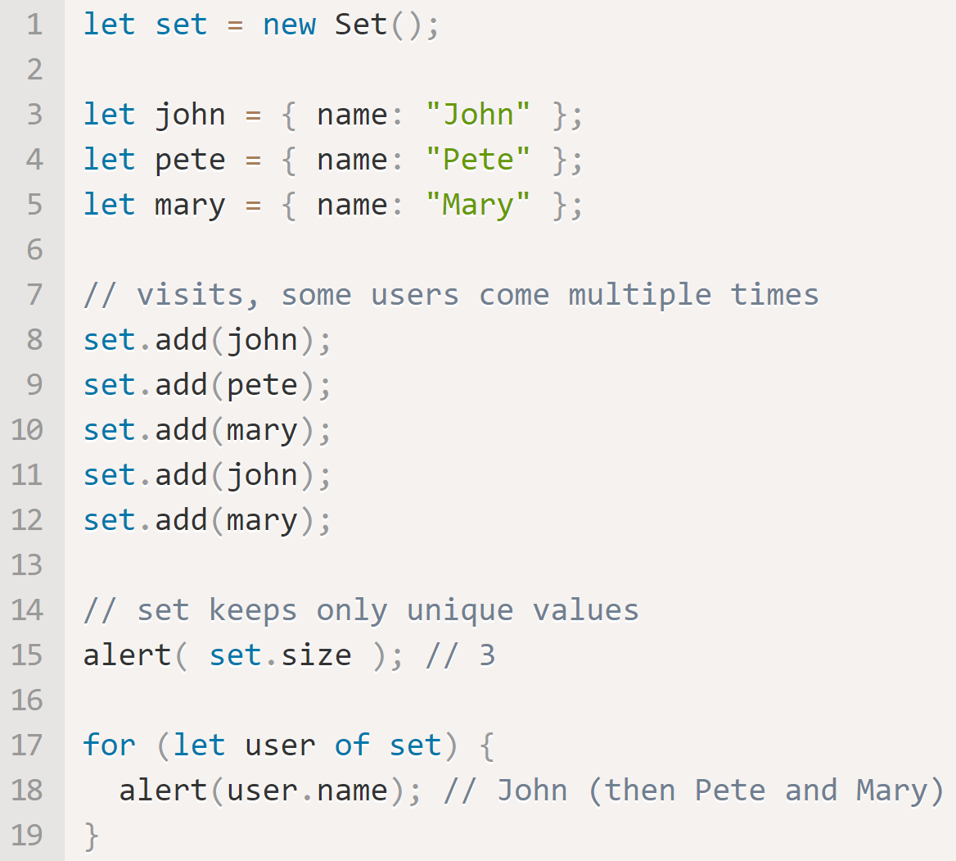
Set https://javascript.info/map-set#set
Set
A Set is a special type collection – “set of values” (without keys), where each value must be unique.
A Set is analogous to an array of strings with code to check for duplicate names.

Slide 24
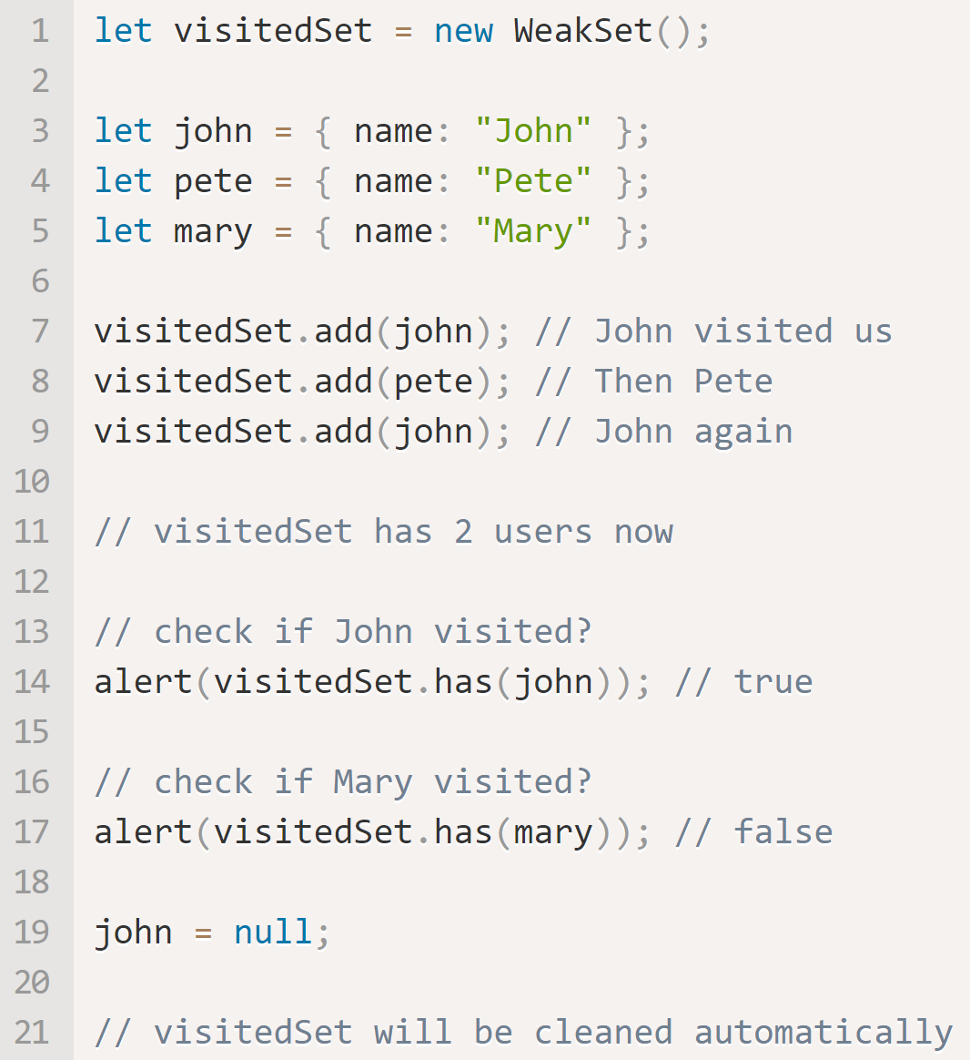
Weak Set https://javascript.info/weakmap-weakset#weakset
Weak Set
Just like Set but only Objects are allowed.
An object exists in the set while it is reachable from somewhere else.
Being “weak”, it serves as additional storage. But only for “yes/no” facts. (use .has(obj) helper function).
WeakSet is not iterable and does not support .size(), or .keys()

Slide 25
User Interaction in a browser – alert, prompt, confirm https://javascript.info/alert-prompt-confirm
The browser functions alert(), prompt() and confirm() allow interaction with the user. You can get input from the user through a pop-up window to which you can print instructions, warnings, or get answers to a question.
alert(message) | prompt(title, [default]) | confirm()
This shows a message and pauses script execution until the user presses “OK”. | Shows a modal window with a text message, an input field for the visitor, and the buttons OK/Cancel. Default is the initial value for the input field. | The function confirm shows a modal window with a question and two buttons: OK and Cancel.

Slide 26
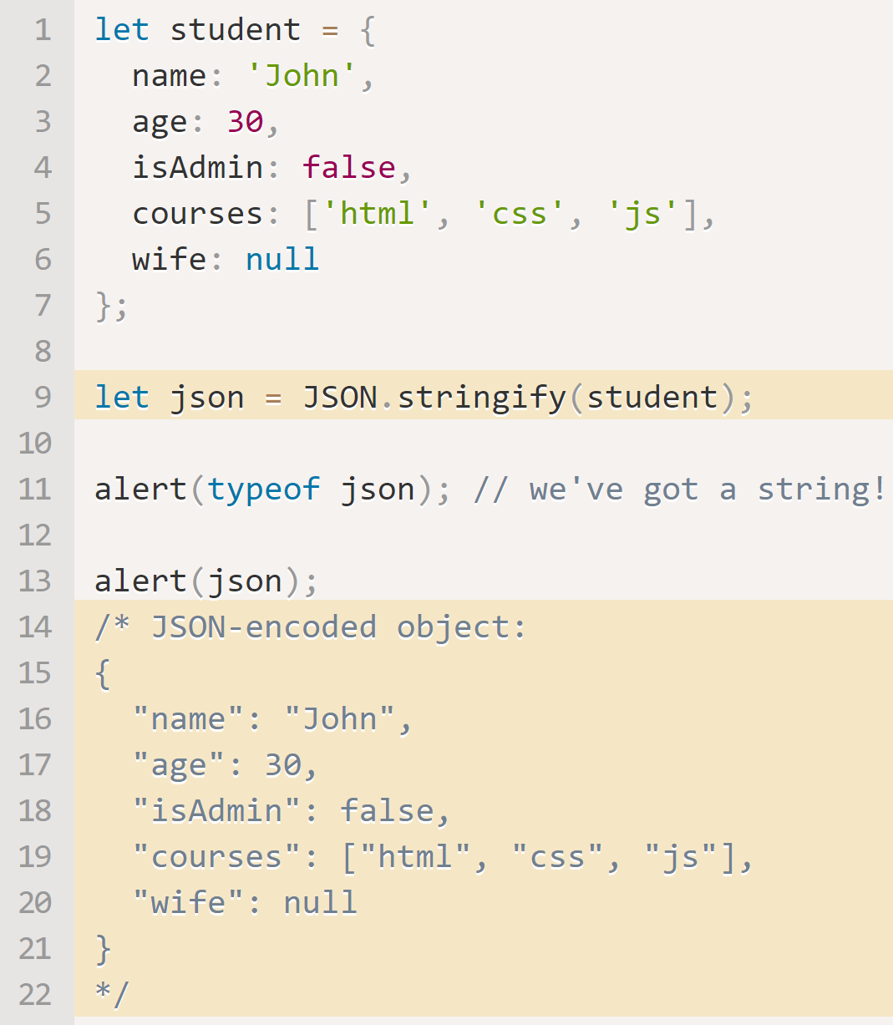
JSON and JSON Methods https://javascript.info/json
JSON (JavaScript Object Notation) was initially made for JavaScript, but now is available anywhere. JSON is used for data exchange. JavaScript provides two JSON methods:
JSON.stringify() to convert objects into a JSON string.
JSON.parse() to convert JSON back into an object.
In this example, the method JSON.stringify(student) takes the object and converts it into a string. The JSON string is called a JSON-encoded, serialized, or stringified object. It is ready to be sent over HTTP or stored in a file, etc.

Slide 27
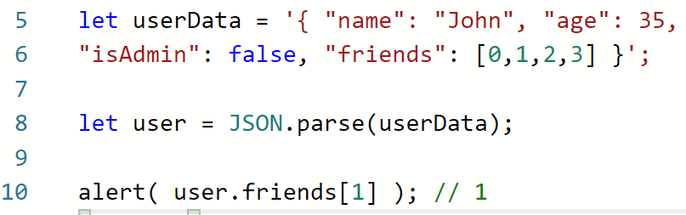
JSON.parse https://javascript.info/json#json-parse
JSON.parse decodes a JSON ‘stringified’ string.
The JSON may be as complex as necessary. Objects and arrays can include other objects and arrays, but they must obey the same JSON format.

